Slide 1

LIBRARY MANAGEMENT SYSTEM

Slide 2


DESIGN
ISSUE BOOK/BORROW BOOKS
ORGANIZE LIBRARY DB
RETURN/ACCEPT THE BOOKS BACK
STUDENT/READER

Slide 3
TOOLS
HTML
CSS
JavaScript
PHP
MYSQL

Slide 4
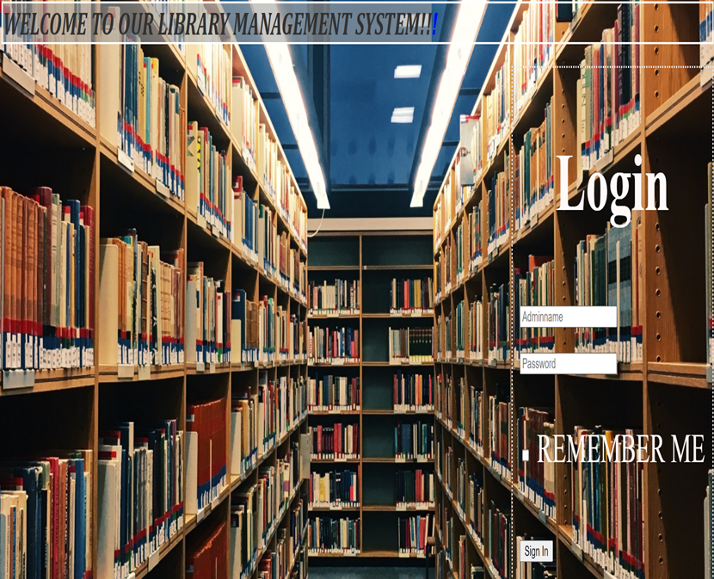
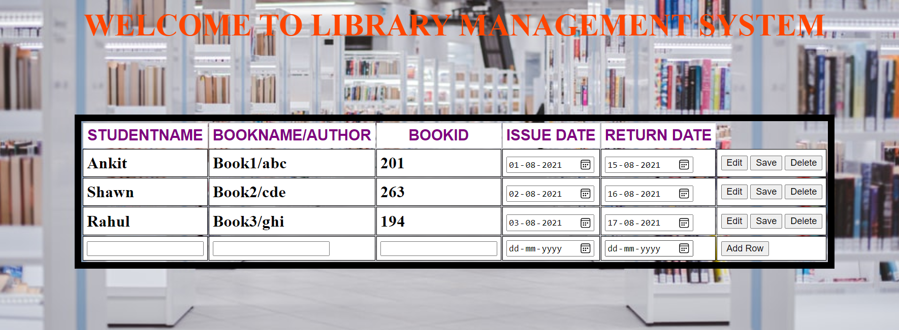

ARCHITECTURE OF THE SYSTEM
Send data to DB
Login.css
Add row()
Enter credentials
Check credentials
TRUE
Validate.php
Login.php
FALSE
Adminpage.php
Admin.css
PRINT “WRONG INFO”
Table_script.js

Slide 5

IMPLEMENTATION

Slide 6
MODULE DESIGN
MODULE1
MAKE SYSTEM COMPATIBLE
MODULE2
IMPLEMENT FRONT END
MODULE3
IMPLEMENT BACKEND

Slide 7
MODULE 1
STEPS FOLLOWED:
1.DOWNLOADED FROM WEB
Visual Studio code
Ver-1.59 for windows
XAMPP-8.0.9

Slide 8
2. DATABASE – MySQL
3.FRONT END DESIGN-
3.1: HTML
3.2: CSS
3.3: JAVASCRIPT
4.BACKEND DESIGN-
4.1:PHP
#
#
#
#
#

Slide 9
MODULE 2-FRONT END Implemention
STEPS FOLLOWED:
1.CREATE A WEB PAGE USING –HTML,CSS AND JAVASCRIPT

Slide 10
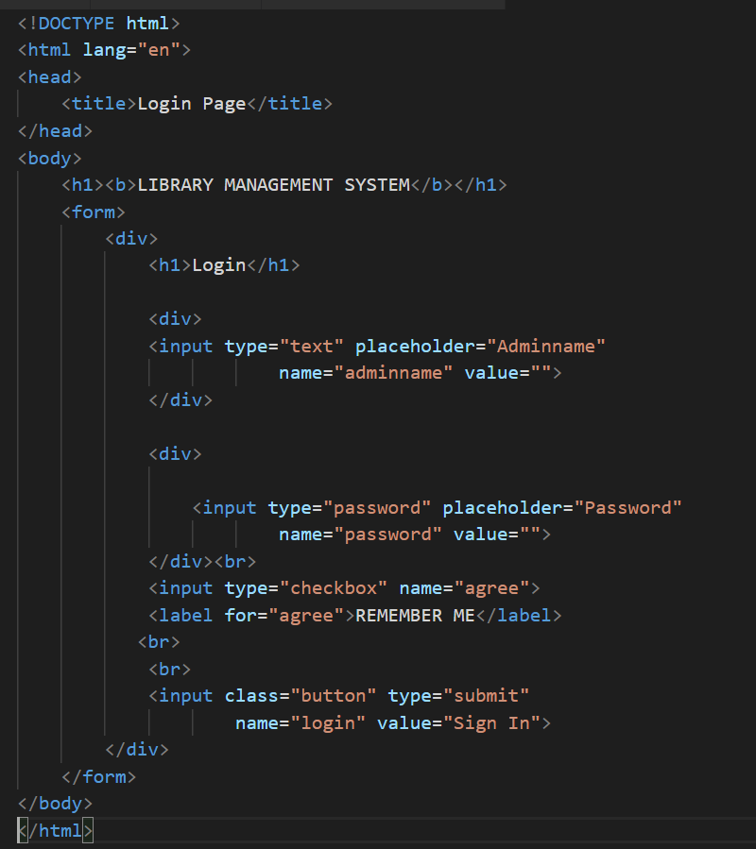
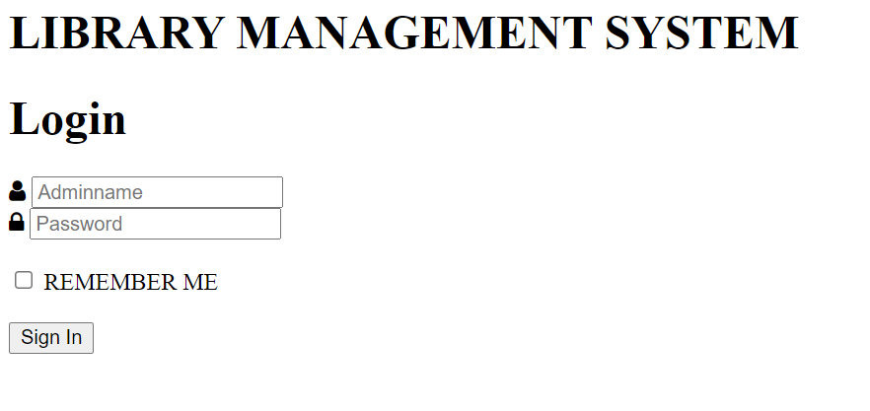
Initial page-html

Slide 11
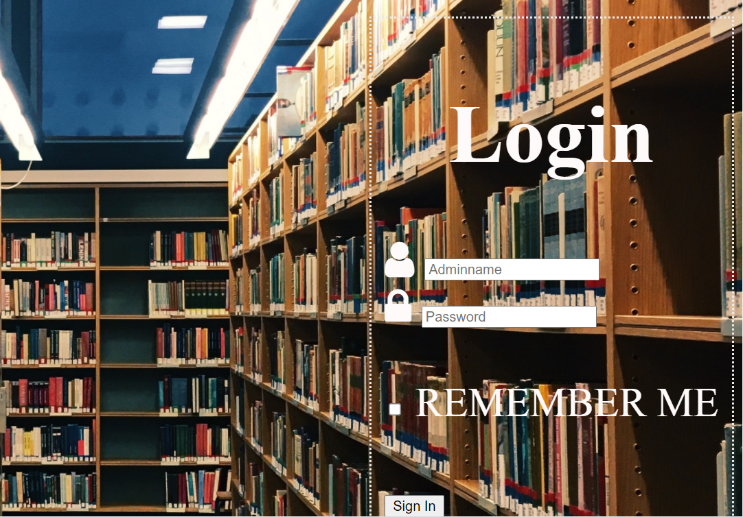
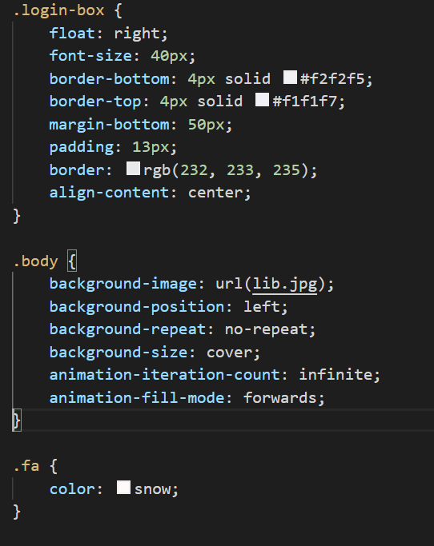
Initial page-css/styling

Slide 12

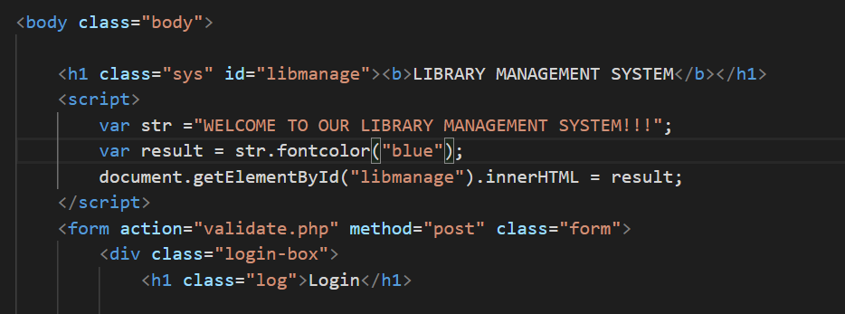
Initial page-javascript

Slide 13
DATABASE DESIGN
DB NAME: loginpage

Slide 14
ER MODEL
BID
STUD_NAME
ID
Username
ADMINLOGIN
Issues/Manages
BOOKISSUE
Password
BOOK_NAME
RDATE
IDATE

Slide 15
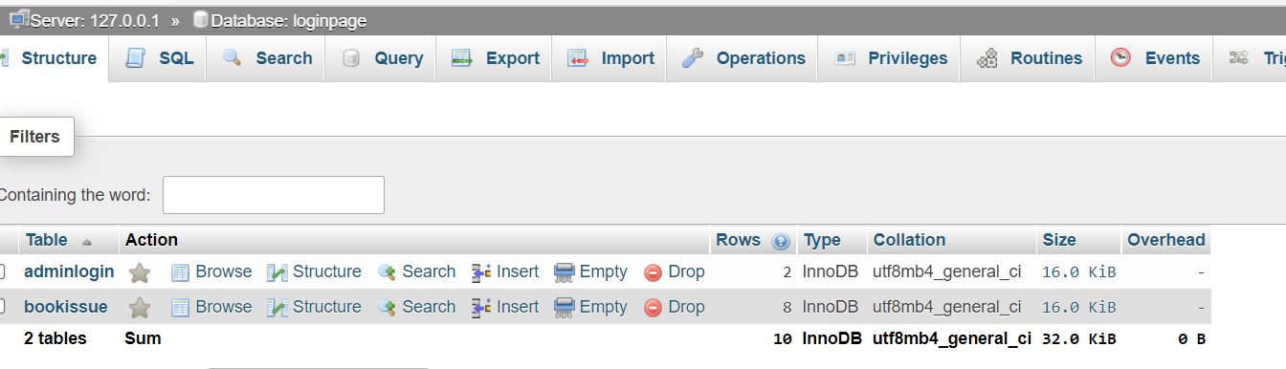
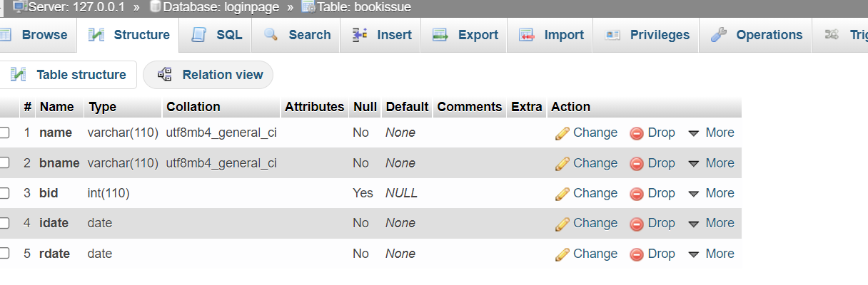
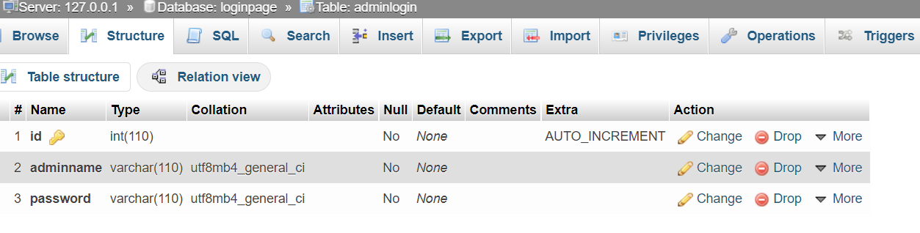

Slide 16
MODULE 3-BACK END Implemention
Used PHP

Slide 17
THANK YOU

